Slide 1
Website Transformation
April 4, 2019

Slide 2
Agenda
Analytics Report
IA Evaluation
Branding Discussion

Slide 3
Donation Button Conversion
Of people who visit the “Make a Donation” Page will actually click on the “make a donate” button.
Of people who visit the “How You Can Help” Page will actually click on the “donate” button.
+
Notes:
Jaimee
out of neon crm
- autmates receipts
-auto populates donors into a data base
paypal pro would need to pay extra-->
Visa signature
neon cna go back in and save your profile
prepoulate

Slide 4
Newsletter Conversion Rates
Of all the unique viewers to a specific page, how many actually signed up for the newsletter
(Conversion Rate = Form Submissions/Unique Views * 100)
These pages produce the most newsletter subscriptions (>5% conversion rate) :
Home
About Little Hero’s League
Thank You
These pages produce and average number newsletter subscriptions (between 1%-5% conversion rate):
Care Coordination
How We’re Unique
About Us
What We Do
What is Care Coordination
+
Notes:
Jaimee
Provide more detail on when they are signing up tot the newletter
-more people ont news letter

Slide 5
Newsletter Conversion Rates cont.
Pages shown below have a high number of views (shown in graph), but low newsletter subscription conversion rate (< 1%)
+
Notes:
Jaimee
fun raiser

Slide 6
Acquisition of Viewers
Search | % of Total
Google | 21.28%
Bing | 0.83%
Yahoo | 0.43%
DuckDuckGo | 0.04%
Comcast | 0.01%
MyWay | 0.01%
Level3 | 0.01%
Ask | 0.01%
Referral | % of Total
livistrong.com | 4.32%
blog.luriechildrens.org | 1.68%
chicago.cbslocal.com | 0.58%
paypal.com | 0.28%
apps.rackspace.com | 0.12%
others | 1.00%
Social | % of Total
Facebook | 9.77%
Instagram | 3.68%
Linkedin | 0.92%
Twitter | 0.16%
Youtube | 0.01%
Email | % of Total
mailchimp | 0.51%
others | 0.63%
+
Notes:
Jaimee
Time stamp add to livi strong

Slide 7
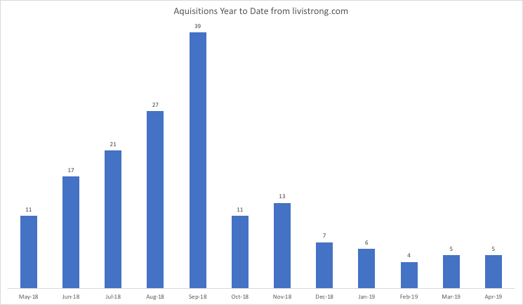
Acquisition of Viewers Cont.

Slide 8
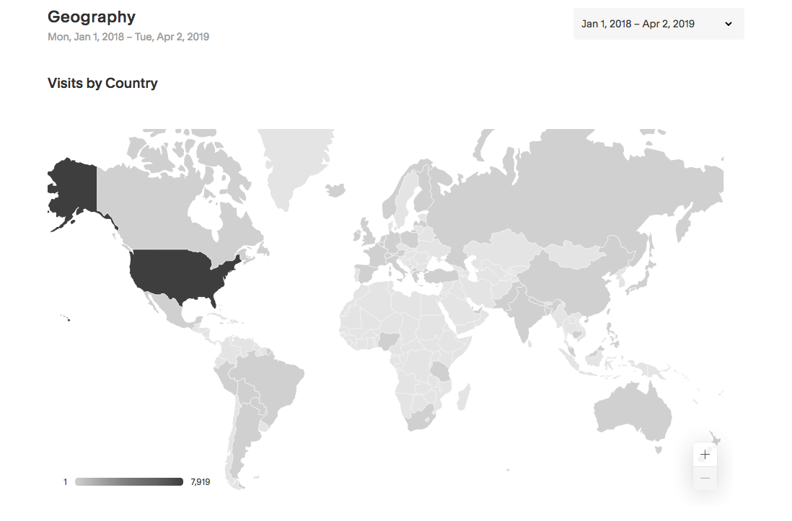
Geography
Location | Percentage of Total
United States | 97.02%
Illinois | 55.78%
Michigan | 10.23%
California | 3.42%
Indiana | 2.41%
Florida | 2.36%
Virginia | 2.20%
Wisconsin | 2.14%
Missouri | 1.93%
Texas | 1.35%
New York | 1.34%
Other states | 12.17%
Canada | 0.84%
China | 0.55%
Ireland | 0.18%
Germany | 0.17%
Other Countries | 1.23%
+
Notes:
Jaimee

Slide 9
Facebook Analysis
What Facebook posts are driving traffic to the website?
Facebook is not driving traffic from Facebook posts even when linked in post
User engagement on Facebook is low
13%
+
Notes:
Jaimee

Slide 10
Financial Timeline
Are events driving website traffic?
+
Notes:
Jaimee

Slide 11
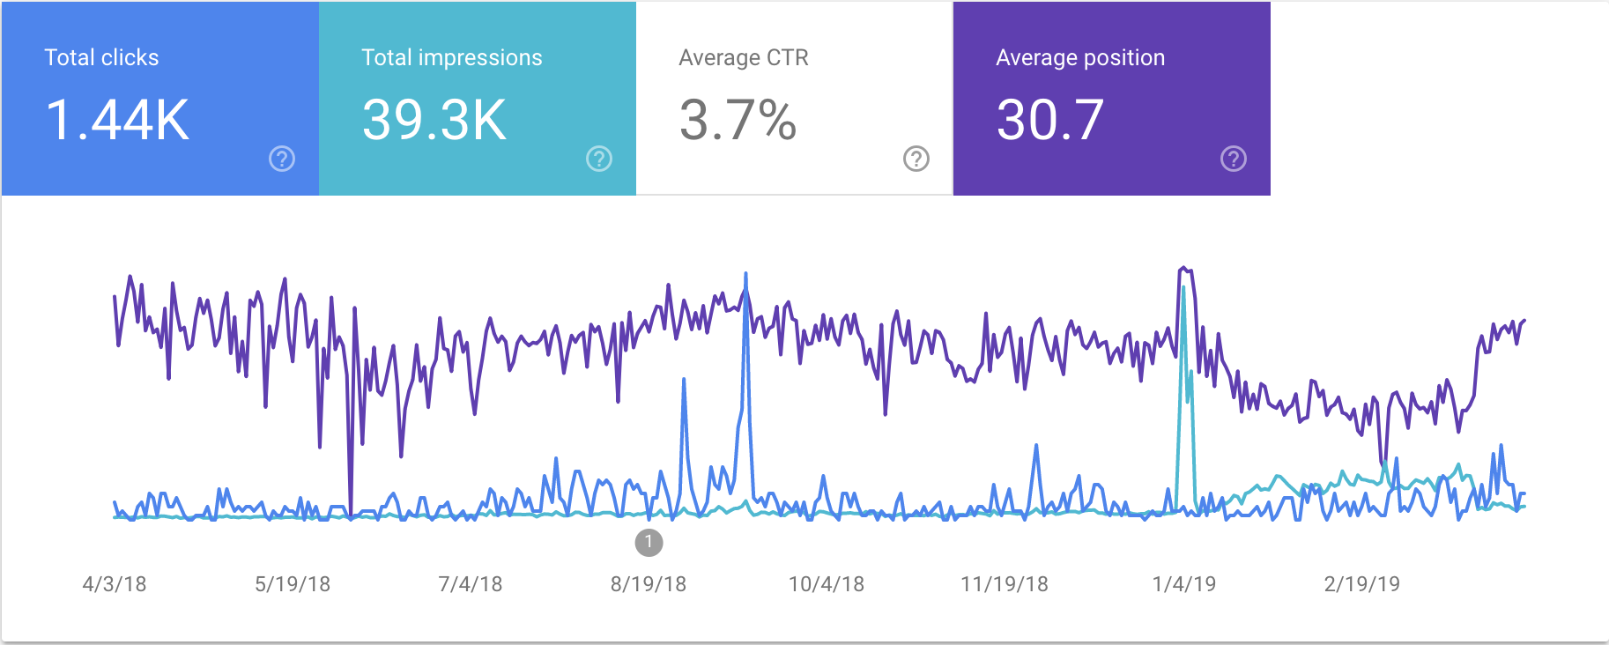
Google Search Click Rate
Of all the times a google search user saw a link to the LHL site in search results, how often did that result in a click?
+
Notes:
Jaimee
industry average
Key word search list
this weekend key word sewrch vs face

Slide 12
Top Google Search Queries
What are the people that reach the LHL website searching?
The google search queries that resulted in the most clicks are listed in order.
Most clicks were a result of a direct search, where the url had a higher position on the screen.
Impressions don’t appear to directly correlate with clicks. For example, the query “little heroes” had the most impressions, but only a 0.88% click-rate.
Query | # of Clicks | Impressions | Avg. Position
little heroes league | 784 | 940 | 1
livistrong | 41 | 411 | 4.1
little heroes | 17 | 1931 | 13.5
little heroes league | 11 | 17 | 1
little heroes foundation | 5 | 478 | 21.5
funraiser | 3 | 1909 | 7
+
Notes:
Jaimee
little heros

Slide 13
Key Takeaways & Next Steps
Up Engagement and traffic from Facebook posts to the website and ultimately to donations.
How to leverage Livi’s blog and share on social media.
Increase conversion rate
Increase Donation %
Increase traffic to donation page
Google Search opportunities
+
Notes:
Jaimee
Race track no fundraiser
GOlf fun raiser
Big Heroes charity golf funaraiser
time line with livis blogs
drive traffic via facebbok ad
- next weeks sometime

