Slide 1
SAP 101 Technical Basics
Grace Connolly, Ava Snaidauf & Jaimee Lombard
Chicago | May 3, 2019

Slide 2
Agenda
Project Lifecycle Overview:
Key stages in a project and the key activities that take place within them
SAP Tables:
How to get to the tables within SAP and what their function is for the grand scheme of the system?
Configuration:
Quick walk through of back-end config. I think most people can perform the transactions that end - user clients do, but the config is something most of us haven't touched at all.
Error Correction:
as new consultants it is highly likely we make a mistake, but our classes continually stressed you can’t delete things in SAP.
GUI and Fiori Relationship:
How GUI correlates with Fiori? Really just showing how they are all connected and how T-codes affect Fiori apps.
Functional Specifications:
Reason for them, tips to writing them, and examples from real documentation.

Slide 3
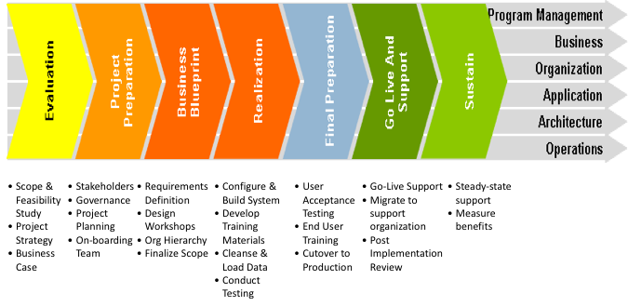
Project Phases

Slide 4
SAP Application Ecosystem

Slide 5
Legend
S/4, ECC – Enterprise Core Component, now referred to as S/4
FI – Finance module
GL – General Ledger
Contains Parallel Ledgers (previously ”Special Ledgers”
AR – Accounts Recev
AP – Accounts Payable
AM – Asset Mgmt
Treasury
EC-CS – Enterprise Consolidation (phased out now that BPC is in place)
CO – Controlling module
PCA – Profit Center Accounting
CCA – Cost Center Acctg
CO-PA – Profitability Analysis (aka, CO-PA)
PS – Project Systems
IO – Internal Orders
ML – Material Ledger
(Product Costing is not a module, per se, but a process to determine COGS which involves other modules)
MM – Materials Mgmt module (ie, for inventory mgmt, and procurement)
PM – Plant Maintenance module
SD – Sales & Distribution module (ie, customer orders)
PP – Production Planning
QM – Quality Management
HR – Human Resources (functionality is largely replaced by SuccessFactors)
HANA – SAP’s database
ABAP – Advanced Business Application Programming (SAP’s proprietary coding language)
Solution Manager (aka, SolMan) – a document repository, and configuration and transport management system
Fiori – A User-Experience (UX) roles-based GUI wrapper around the SAP core
SAP BW – Business Warehouse
DSO – Data Storage Object
BPC – Business Planning & Consolidation
Replaces SEM-BPS and SEM – BCS
BOBJ – Business Objects
MDM – Master Data Management
MDG – Master Data Governance
POS-DM / CAR – Point-of-Sale, Customer Activity Repository
APO – Advanced Planning & Optimizing
GTM – Global Trade Mgmt
CRM – Customer Relationship Mgmt
SRM – Supplier Resource Mgmt
SCM – Supply Chain Mgmt
GRC – Governance, Risk, & Compliance
Concur – Travel & Expense
Ariba / Fieldglass – Indirect Procurement / Vendor Mgmt
C/4HANA (fka Hybris) – Enterprise Omnichannel & Product Content Mgmt
SuccessFactors – Cloud-based Human Capital Mgmt
Payroll is part of solution
HCM – Human Capital Mgmt
PO – Process Orchestration (middleware)
SLT – System Landscape Transformation

Slide 6
Tables 101
T-Code to extract tables: SE16n
Common Tables by Functional areas:
Supply Chain | Finance | Sales | Master Data
MARA: Basic data for materials MARC: Plant-specific material data AUSP: Classification table AFKO: Production Orders EINA/EINE: Purchase Information Record LFA1/LFB1/LFM1 - Vendor Master Tables | SKA1- GL Accounts (COA) SKB1- GL Accounts (Comp Code) BKPF- Accounting Documents Header BSEG- Item Level ANKA- Asset Class FAGLFLEXA- GL actual line items A132- Price per Cost center | BUT000 - BP General BUT100 - BP Roles KNVV - Customer Sales Area VBAK- Sales Document Header VBAP- Sales Document Item | Customer Master: KNA1 Vendor Master: :LFA1 Master Bank Data: BNKA Profit Center Master: CEPC ANLA- Asset Master Record

Slide 7
SAP Organizational Chart

Slide 8
SAP Design & Realize Project Phases

Slide 9
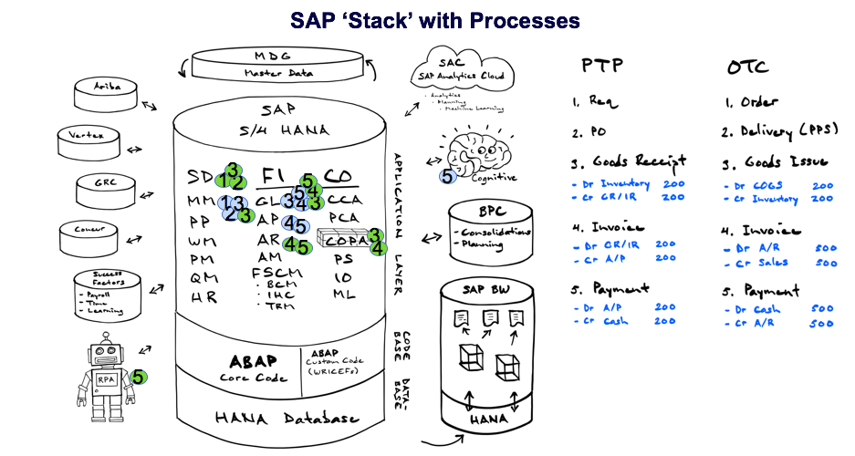

Slide 10
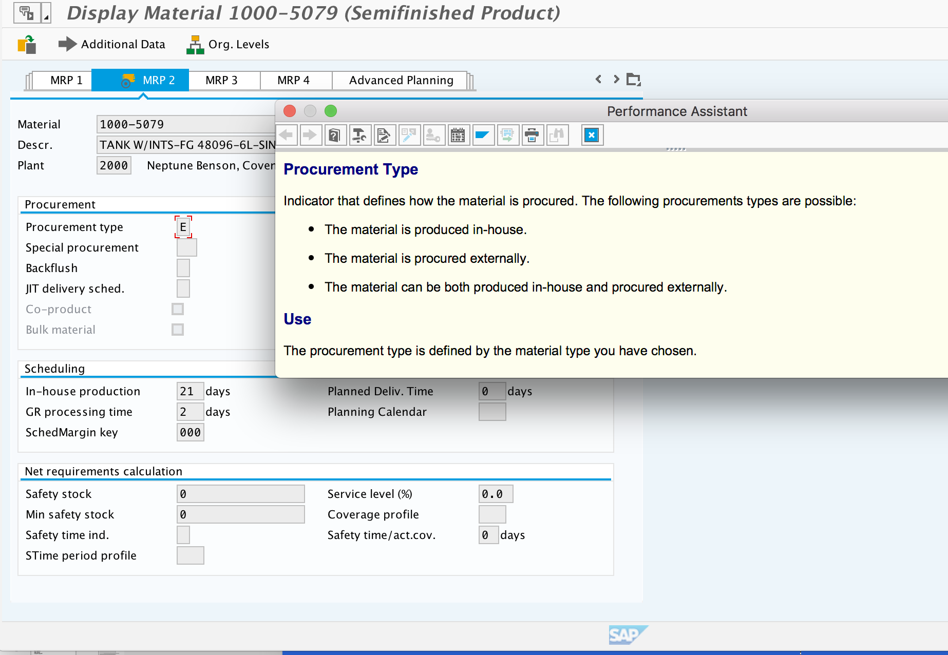
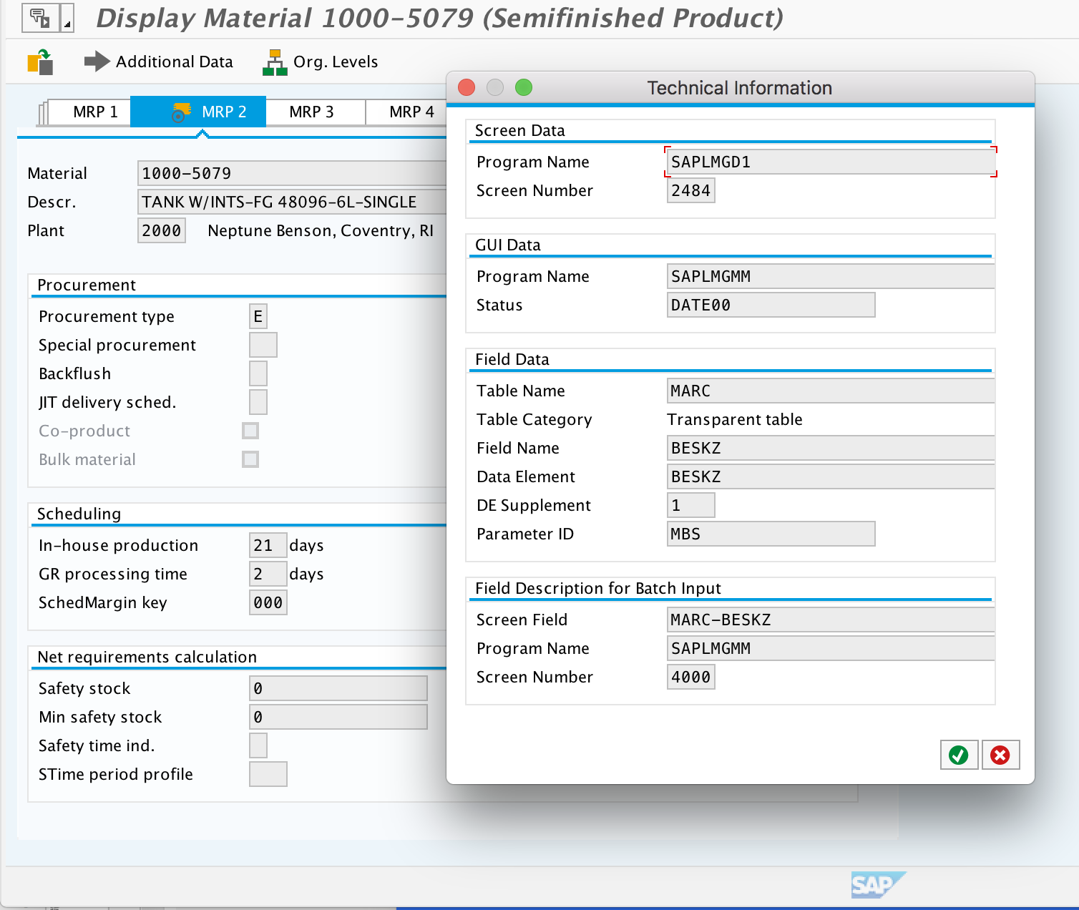
Finding Technical Field Name & Table
Directions: Click in field. Press F1. Click on hammer and wrench symbol. In this example, table is MARC and field is BESKZ

Slide 11
Configuration
T-Code: SPRO
Transports: move data to/from different environments in the system
Master data: objects are created and then assigned to different elements in the organization structure
Other objects are created like a switch board where you turn on and off keys to enable certain functionality
WRICEFS can be created through unique coding
Demo: Creating MRP Controllers

Slide 12
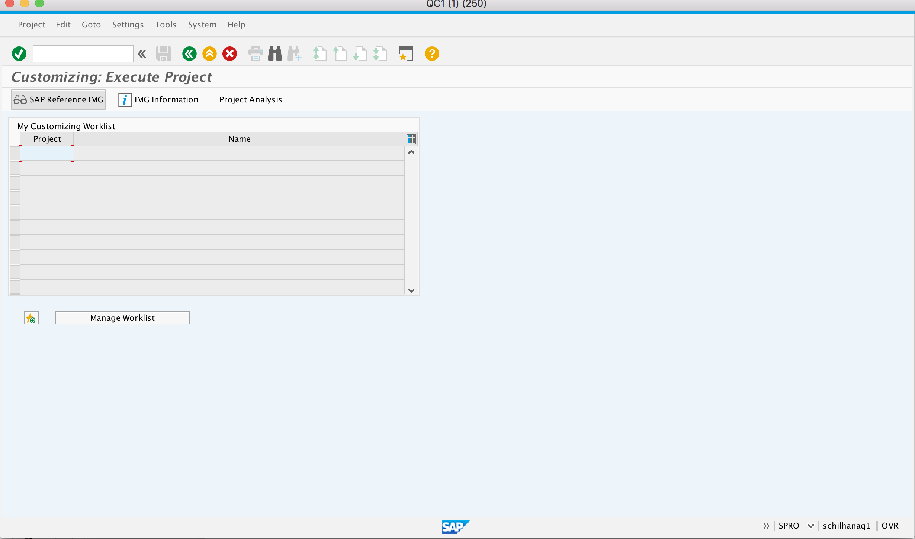
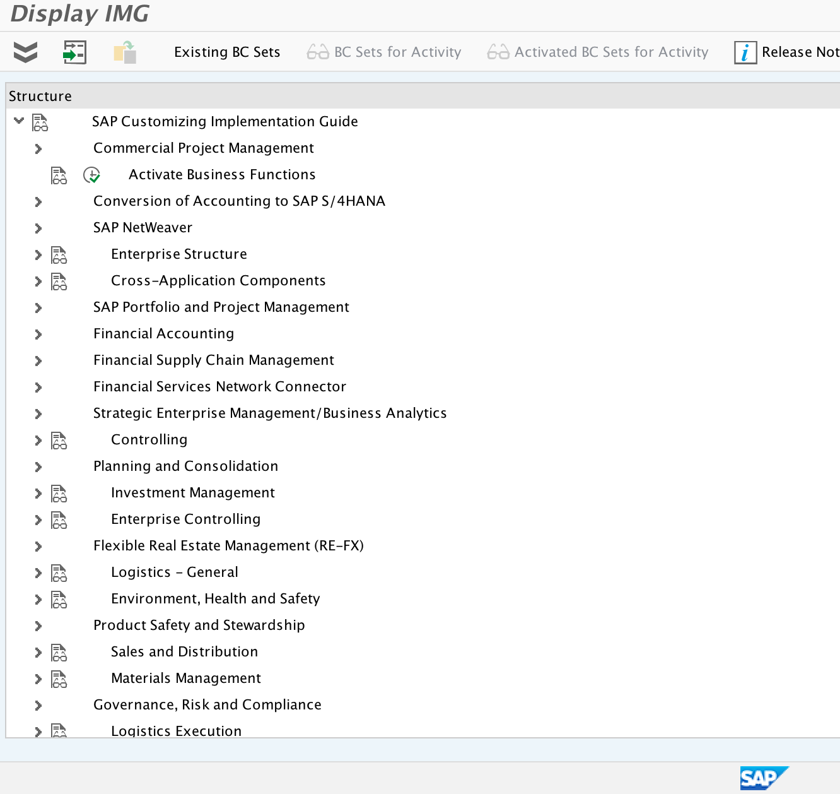
Screenshots for Reference
T-Code: SPRO. Click SAP Reference IMG. Then expand sections to enter places to config

Slide 13
Tables 101
Transport: a way of moving configuration data from one environment to another
Production
Customizing Request: specific to the client you create it in
Ex) at Evoqua Dev 250 → Dev 350 → Quality → Production
Testing at each step in the process
Workbench Request: reflected in all clients
For the technical consultant
The end user can see your changes and use
Quality
Move & Test
Dev 350
Move & Test
Dev 250
Configuration Initiates

Slide 14
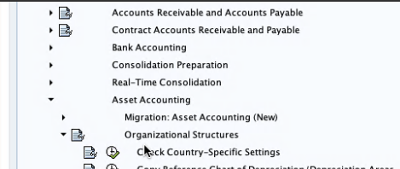
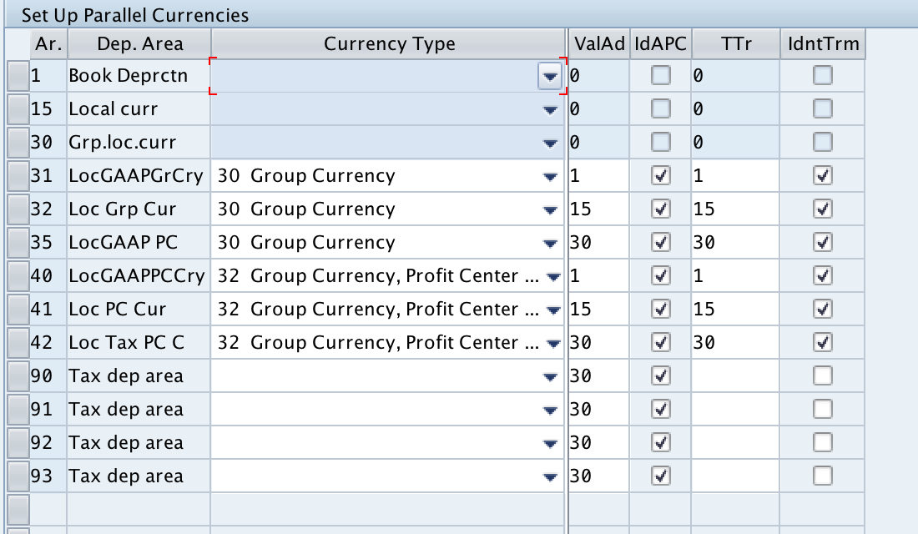
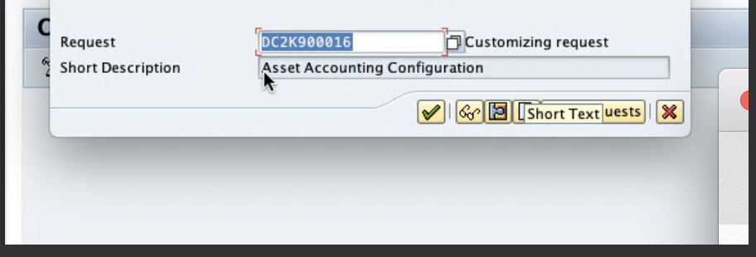
Creating Transports
SPRO
Make a Change
Configuration new Chart of Depreciation for a new country of operation
Define the depreciation areas
Save
Will generate a Transport pop-up for Customizing Request
Choose Create
Enter Description (can change later)
Select Execute & TR number is generated
D122345678

Slide 15
Creating Transports
Outside of SAP
Send message to ABAPer to move transport to new system
Requirements for this are project specific
Business justification required

Slide 16
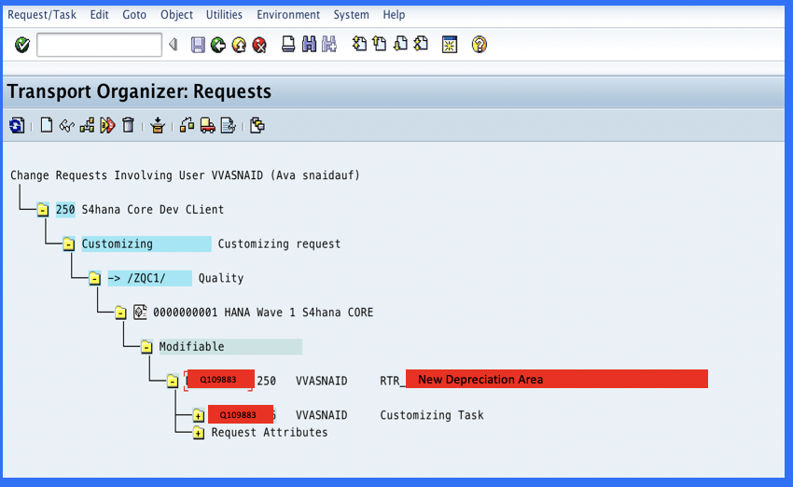
Creating Transports
SE10 Transport Organizer
Filter by user/type of request
Display transports
Select Release @ Customizing Task level first

Slide 17
Fixing Errors
Most Everything can be backed out…but is not ideal
Master data elements cannot be deleted, but “marked for deletion” For example, if a material is messed up, you can mark for deletion in MI04. This prevents MRP running on it and will flag if someone is trying to use it.
If you are testing and mess up an action, you can typically back out transactions in the logistics space. However, don’t back out without guidance due to potential financial impacts of each transaction.
There is little you will be creating from scratch, you will eventually build up a tool belt of “troubleshooting” techniques to prevent errors.
Question:
Error Correction: as new consultants it is highly likely we make a mistake, but our classes continually stressed you can't delete things in SAP.

Slide 18
Fiori vs GUI
GUI is the “back-end” and Fiori is the front “end”
Fiori is brand new and intended to make it easier for end users to adopt
There are apps (Fiori) that correlate directly to t-codes (GUI) and some brand new apps which are strictly Fiori
All actions in Fiori are recorded in GUI
Fiori is not meant to be a 1 to 1 mapping of apps to t-codes (clients ask this)
Demo: test script in Fiori and GUI to show relationship
Question:
GUI and Fiori Relationship: How GUI correlates with Fiori? Really just showing how they are all connected and how T-codes affect Fiori apps.

Slide 19
Contact Information
Grace Connolly
Grace.Connolly@ibm.com
872-769-0602
Plan to Manufacture
Ava Snaidauf
Ava.snaidauf@ibm.com
312-438-0578
Record to Report
Jaimee Lombard
Jaimee.Lombard@ibm.com
312-256-1205
Procure to Pay/Ariba

